Slide 1
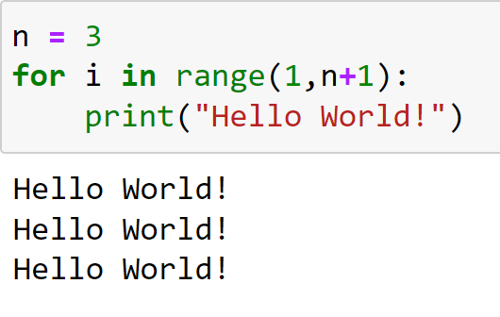
Binary Searches Programming and Algorithms
Lecture by
Dr Daniil Osudin

Slide 3
What will we Cover?
Binary search algorithm
Understanding the efficiency of the algorithm using big-O notation

Slide 4
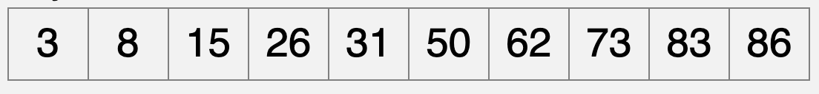
Binary Search
Faster method, but list must be ordered
It splits the data list into two sub lists and repeats the process until a search key is found
Binary search example
Search key is: 50
List is:

Slide 5
Binary Search Algorithm
set index = -1
set first to start of list
set last to end of list
input search key
while first <= last
index = (first + last) // 2 # set index to middle of list
if list[index] == key
print(key found in list)
break
else
if list[index] > key
last = index - 1
else
first = index + 1
If key not yet found
print(key not found in list)

Slide 6
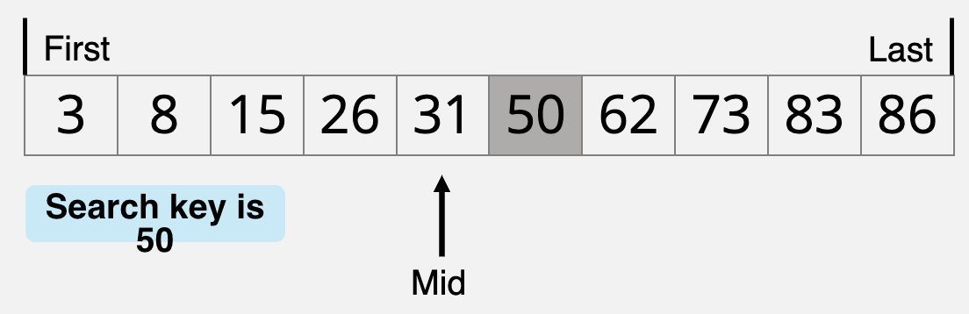
Tracing the Behaviour of the Binary Search

Slide 7
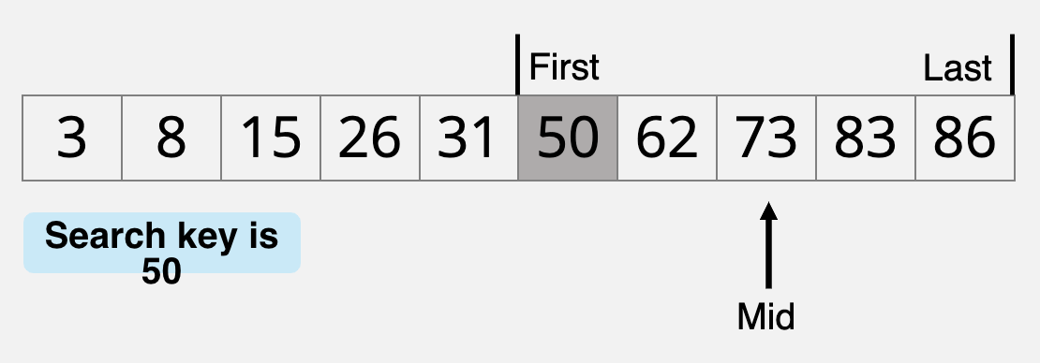
Tracing the Behaviour of the Binary Search

Slide 8
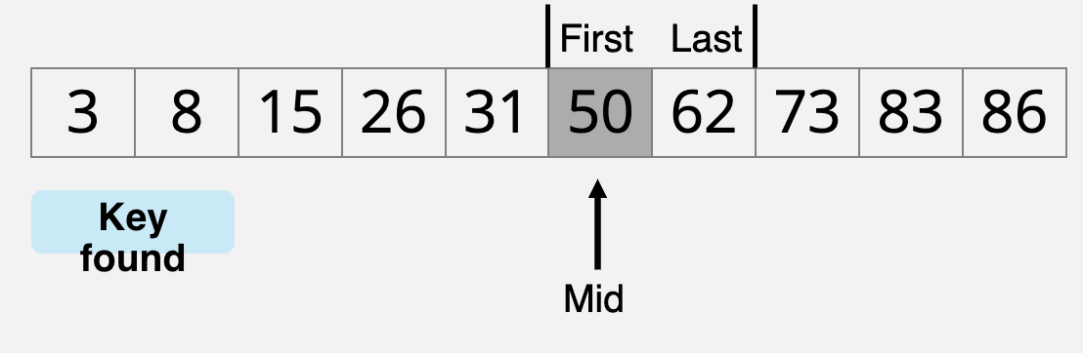
Tracing the Behaviour of the Binary Search

Slide 9
Try It Yourself I
Trace the behaviour of the binary search algorithm for the same list, but with the search key of 65

Slide 10
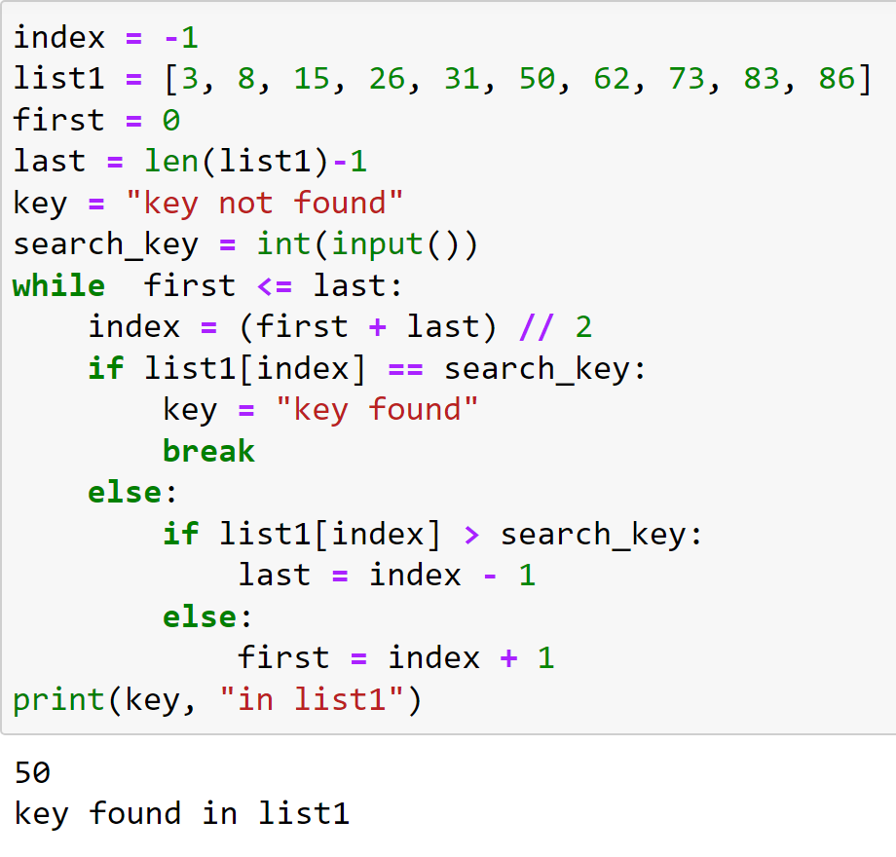
Binary Search Example
user input search_key is 50
search_key = 50
first = 0
last = 9
index = -1
list1[?] = ?

Slide 11
Binary Search Example
0 <= 9 evaluates to True
search_key = 50
first = 0
last = 9
index = 4
list1[?] = ?
(0 + 9) // 2 = 4

Slide 12
Binary Search Example
31 == 50 evaluates to False
search_key = 50
first = 5
last = 9
index = 4
list1[4] = 31
31 > 50 evaluates to False
first = 4 + 1 = 5
The end of loop body is reached, so execution jumps back to the beginning of the loop and the condition is tested again

Slide 13
Binary Search Example
5 <= 9 evaluates to True
search_key = 50
first = 5
last = 9
index = 7
list1[?] = ?
(5 + 9) // 2 = 7

Slide 14
Binary Search Example
73 == 50 evaluates to False
search_key = 50
first = 5
last = 6
index = 7
list1[7] = 73
73 > 50 evaluates to True
last = 7 - 1 = 6
The end of loop body is reached, so execution jumps back to the beginning of the loop and the condition is tested again

Slide 15
Binary Search Example
5 <= 6 evaluates to True
search_key = 50
first = 5
last = 6
index = 7
list1[?] = ?
(5 + 6) // 2 = 5

Slide 16
Binary Search Example
50 == 50 evaluates to True
search_key = 50
first = 5
last = 6
index = 5
list1[7] = 50
Key is set to found
break terminates the execution of the loop

Slide 17
Binary Search Example
search_key = 50
first = 5
last = 6
index = 5
list1[7] = 50
Print that the value is found in the list

Slide 18
Analysis
Binary search runs in logarithmic time, which means the number of iterations cannot be more than log n + 1, n being the size of the list
Example
when n = 100
log₂ n + 1 = 6.64 + 1 = 7.64
The worst case scenario would require log n computations. The search will need no more than 8 iterations
The big-O notation for binary search is O(log n)

Slide 19
Linear and Binary Search Comparison
Linear Search | Binary Search
Is simple to code and implement | Is more complex to code
Quite efficient for short length data lists | Efficient for any length of data list
Very slow on large lists since each data element has to be compared | Fast on any length of data list since it only deals with half sub-lists. Hence the name is binary search
Does not require data to be ordered | Data has to be ordered
Average search length is n/2 where n is the number elements in the list | Search length is log n
Plays a part in other algorithms such as finding maximum, minimum and also in some sorting routines | Binary search is used in fast searching routines

Slide 20
Try It Yourself II
Write a program in python environment that takes a alphabetically sorted string and a character as an input and finds whether the character is found within the string using a binary search

